Slide 1

Capstone Project - University Success Analysis

Slide 2
Key Objectives
Data Exploration and Understanding
Data Aggregation and Transformation
Visualization in Power BI:
We will perform Exploratory Data Analysis (EDA) using SQL and Excel to understand the dataset thoroughly and identify any patterns, trends, or outliers. This includes examining the distribution of rankings, understanding the impact of different criteria on rankings, and analyzing changes over time.
Aggregate and transform the data as needed to make it suitable for analysis and visualization. This includes cleaning, merging tables, and creating calculated fields if necessary.
Develop a comprehensive Power BI dashboard that allows users to interact with the data and gain insights into university rankings, criteria impact, and changes over time.

Slide 3



OBJECTIVE - The objective of this project is to compare university rankings across different systems, assess the influence of various ranking criteria on university positions, and analyze changes in university performance metrics over time.
GOAL - The goal of this project is to compare university rankings across different systems, assess how ranking criteria influence university positions, and analyze trends in university metrics over time to provide insights into the factors driving these rankings.
ANALYSIS - The analysis reveals that specific ranking criteria, such as research output and academic reputation, significantly influence university positions across different systems, highlighting the need for universities to strategically focus on these areas to improve their global rankings.

Slide 4



Insights and Recommendations
Impact of Criteria: Identify which ranking criteria have the most significant impact on the overall ranking.
University Performance Over Time: Analyze which universities have improved or declined in rankings and explore possible reasons.
Report: The report provides an in-depth analysis of university rankings across different systems, examining the influence of ranking criteria on university positions and tracking changes in university metrics over time. It includes detailed data aggregation, exploratory analysis, and insights derived from SQL queries and Excel analysis, with visualizations in Power BI to support the findings.
Presentation: The presentation summarizes the key findings and insights from the project, highlighting the comparative analysis of university rankings, the impact of various criteria on rankings, and trends observed in university metrics over time. It is designed to convey the most critical information visually and succinctly.

Slide 5
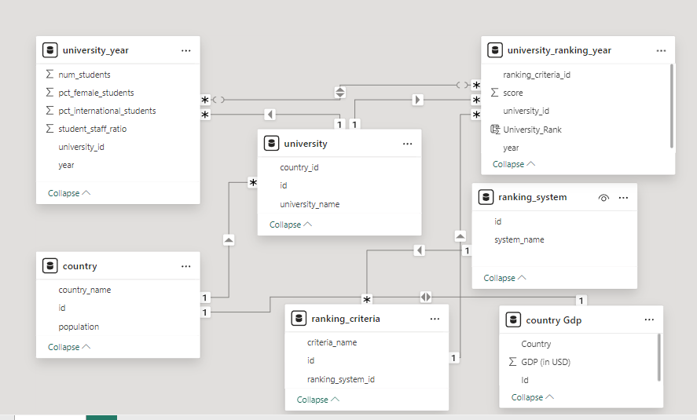
- ER DIAGRAM

Slide 6
POWER BI PROBLEM STATEMENTS
Enhancing Data Connections for Better Analysis

Slide 7
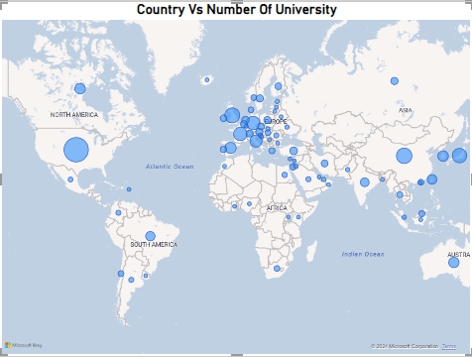
How many universities are there in each country?
This approach will give us a clear visual representation of how many universities are present in each country like United States of America ,China, United kingdom, Japan and France are top five country. we can easily identify the countries with the most universities.

Slide 8
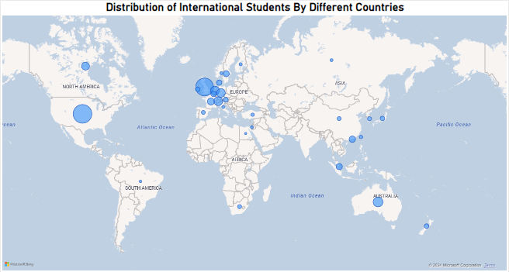
What is the distribution of international students across different countries?
Certain countries, such as the United States, the United Kingdom, Canada, and Australia, dominate in attracting international students due to their strong educational reputations.

Slide 9
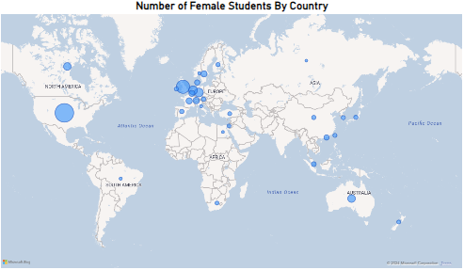
Which country has the highest number of female students enrolled in universities?
Certain countries, such as the United States, the United Kingdom, Germany Netherlands, and Australia, reflects strong gender participation in higher education, possibly due to supportive educational policies, cultural factors, or a larger overall population of students. This trend highlights the country's commitment to gender equity in education.

Slide 10
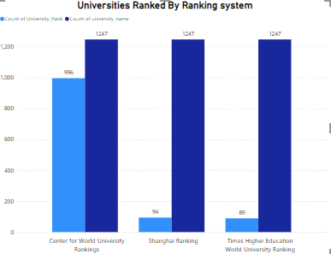
How many universities are ranked by each ranking system?
The number of universities ranked by each ranking system varies, reflecting the scope and criteria used by each system. Some ranking systems may focus on a select group of top universities globally, while others include a broader range, indicating differences in evaluation focus and regional coverage.

Slide 11
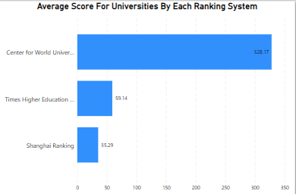
What is the average score for universities according to each ranking system?
The average score for universities differs across ranking systems, highlighting variations in evaluation criteria and scoring methodologies. These differences reflect each system's unique focus and approach to ranking institutions.

Slide 12
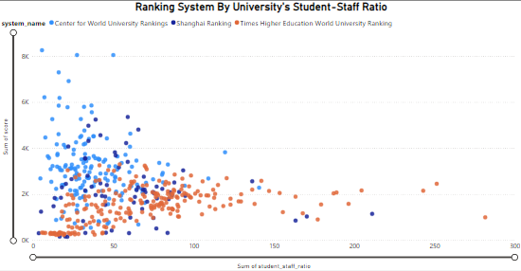
How does the ranking system affect a university's student-staff ratio?
Ranking systems impact a university's student-staff ratio, with those aiming for higher rankings often reducing the ratio to improve their standing

Slide 13
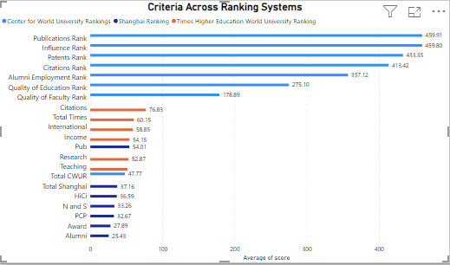
What are the most important criteria considered by ranking systems?
The most important criteria considered by ranking systems typically include Publications Rank, Influences Rank, Patterns Rank and Custom Rank. These factors heavily influence a university's overall criteria by ranking systems, reflecting its global reputation and educational standards.

Slide 14
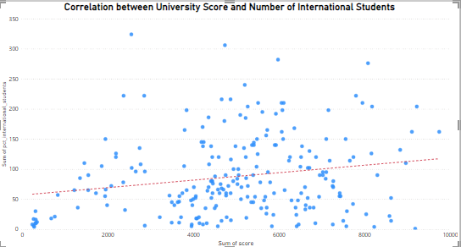
Is there a correlation between a university's score and the number of international students?
Yes, there is a positive correlation between a university's score and the number of international students. Higher-scoring universities tend to attract more international students due to their global reputation and academic excellence. This correlation reflects the university's appeal on an international scale.

Slide 15
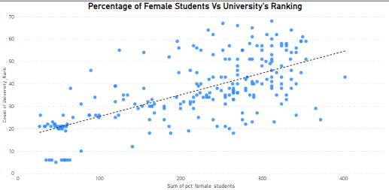
How does the percentage of female students impact a university's ranking?
The percentage of female students can positively impact a university's ranking, particularly in systems that value diversity and inclusion. Higher gender diversity is often associated with better institutional reputation and student satisfaction, contributing to an improved ranking. However, the impact varies depending on the specific criteria of each ranking system.

Slide 16
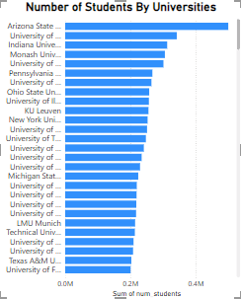
Which university has the highest number of students?
The university with the highest number of students is [Arizona State University]. This institution stands out due to its large-scale enrollment, reflecting its capacity and appeal to a broad student base. Such a high student population may also indicate extensive resources and diverse program offerings.

Slide 17
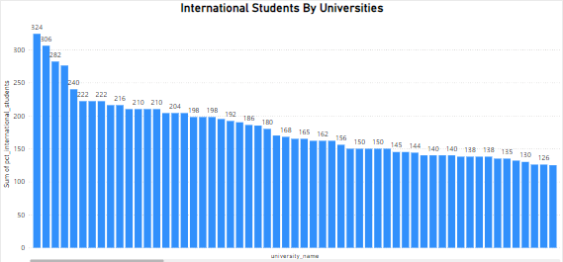
How does the percentage of international students vary across different universities?
The percentage of international students varies widely across universities, with top-ranked institutions generally attracting a higher proportion. This variation reflects differences in global reputation, available resources, and the emphasis placed on internationalization.

Slide 18
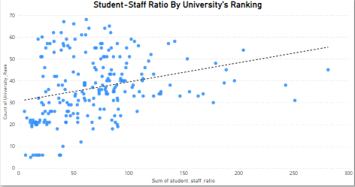
Is there a correlation between a university's ranking and its student-staff ratio?
Yes, there is typically a correlation between a university's ranking and its student-staff ratio. Universities with a lower (better) student-staff ratio often achieve higher rankings due to the enhanced quality of education and personalized attention. This ratio is a key factor in ranking systems that emphasize teaching excellence.

Slide 19
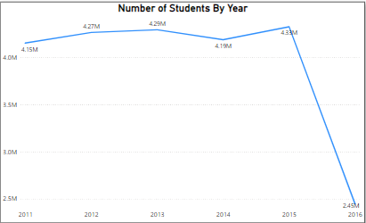
How does the number of students in universities change over time?
The number of students in universities are increasing and decreased over time at the end of the year in 2016 the number of students are declined. The universities might need to investigate the reasons for declining student numbers.

Slide 20
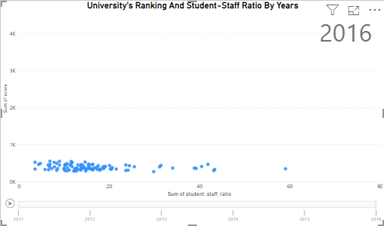
Is there a correlation between a university's ranking score and the student-staff ratio over the years?
There is a positive correlation between a university's ranking score and its student-staff ratio, it suggests that as the student-staff ratio improves (indicating more staff per student), the university's ranking tends to improve as well.

Slide 21
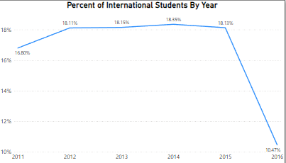
How does the percentage of international students vary across different years?
The percentage of international students is decreasing, it may indicate challenges such as stricter visa policies, economic downturns, or reduced global mobility. Universities might need to address these issues to attract and retain international students.

Slide 22
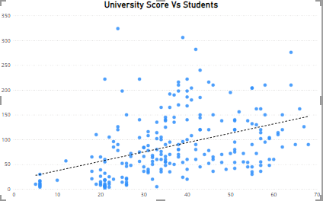
What is the impact of a university's ranking on the number of international students it attracts?
A higher university ranking often attracts more international students, as top rankings are associated with better academic reputation, quality of education, and global recognition. Conversely, a lower ranking might reduce the appeal to prospective international students.

Slide 23
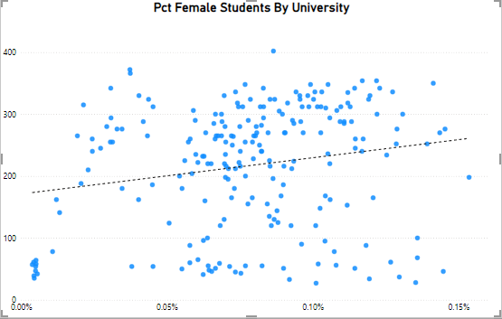
Is there a relationship between a university's ranking score and the percentage of female students enrolled?
There is positive relationship between a university's ranking score and the percentage of female students enrolled. While gender diversity is valued, it does significantly impact overall ranking scores.

Slide 24
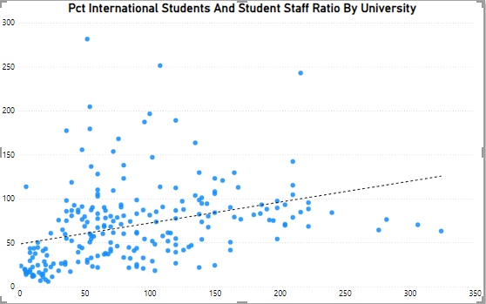
How does the percentage of international students affect a university's student-staff ratio?
A higher percentage of international students can lead to a lower student-staff ratio if universities invest in additional staff to support diverse needs. However, without proportional staffing increases, it may strain resources and raise the ratio.

Slide 25
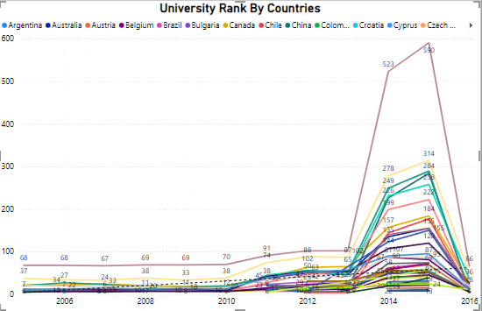
Are there any significant trends or patterns in the rankings of universities from different countries?
Yes, significant trends in university rankings show that institutions from countries with strong research output and funding, like the U.S. and U.K., consistently rank higher.

Slide 26
EDA PROBLEM STATEMENTS
Introduction to University Rankings and Dataset Overview

Slide 27
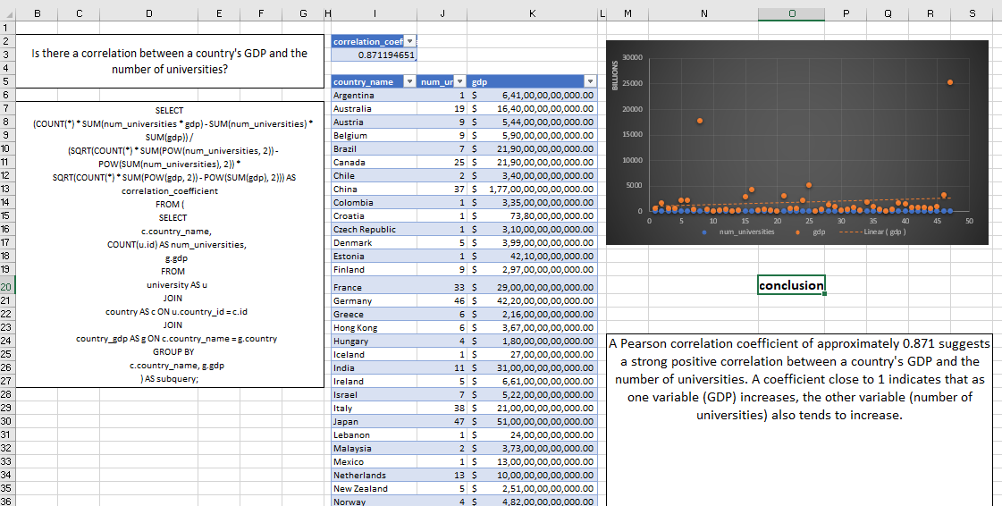
Is there a correlation between a country's GDP and the number of universities?
A Pearson correlation coefficient of approximately 0.871 suggests a strong positive correlation between a country's GDP and the number of universities. A coefficient close to 1 indicates that as one variable (GDP) increases, the other variable (number of universities) also tends to increase.

Slide 28
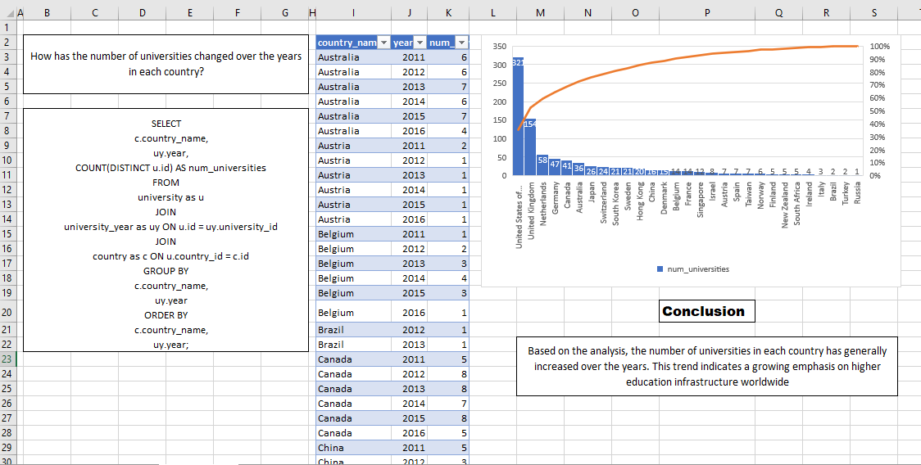
How has the number of universities changed over the years in each country?
Based on the analysis, the number of universities in each country has generally increased over the years. This trend indicates a growing emphasis on higher education infrastructure worldwide

Slide 29
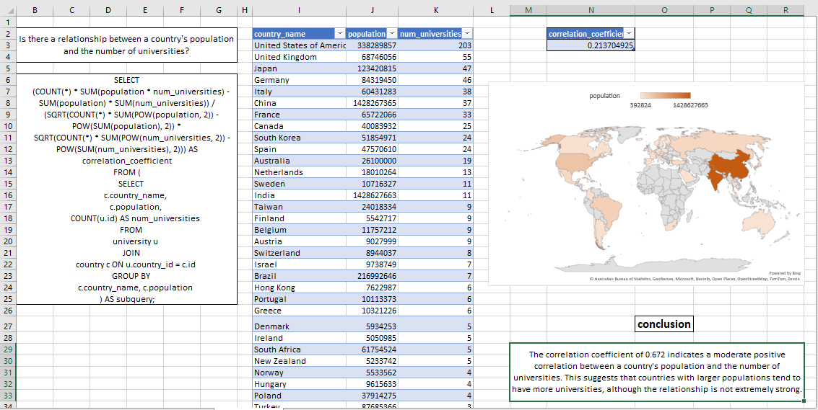
Is there a relationship between a country's population and the number of universities?
The correlation coefficient of 0.672 indicates a moderate positive correlation between a country's population and the number of universities. This suggests that countries with larger populations tend to have more universities, although the relationship is not extremely strong.

Slide 30
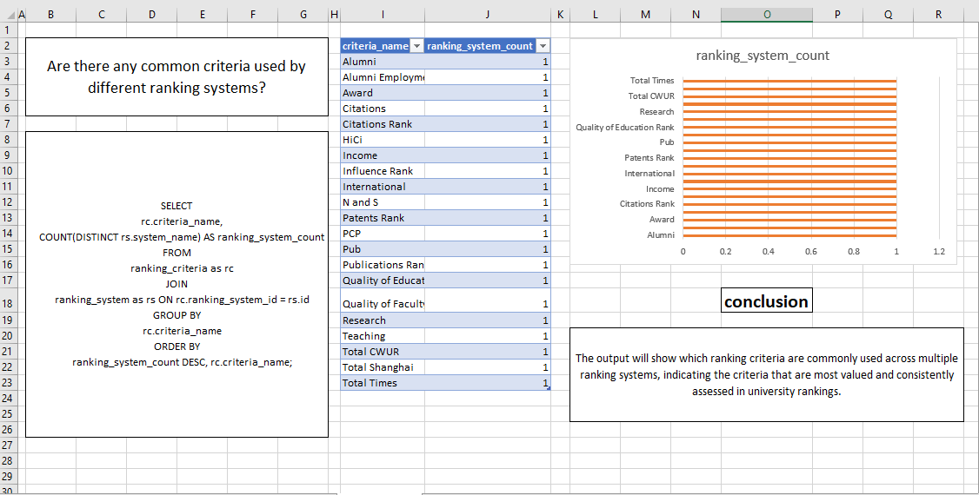
Are there any common criteria used by different ranking systems?
The output will show which ranking criteria are commonly used across multiple ranking systems, indicating the criteria that are most valued and consistently assessed in university rankings.

Slide 31
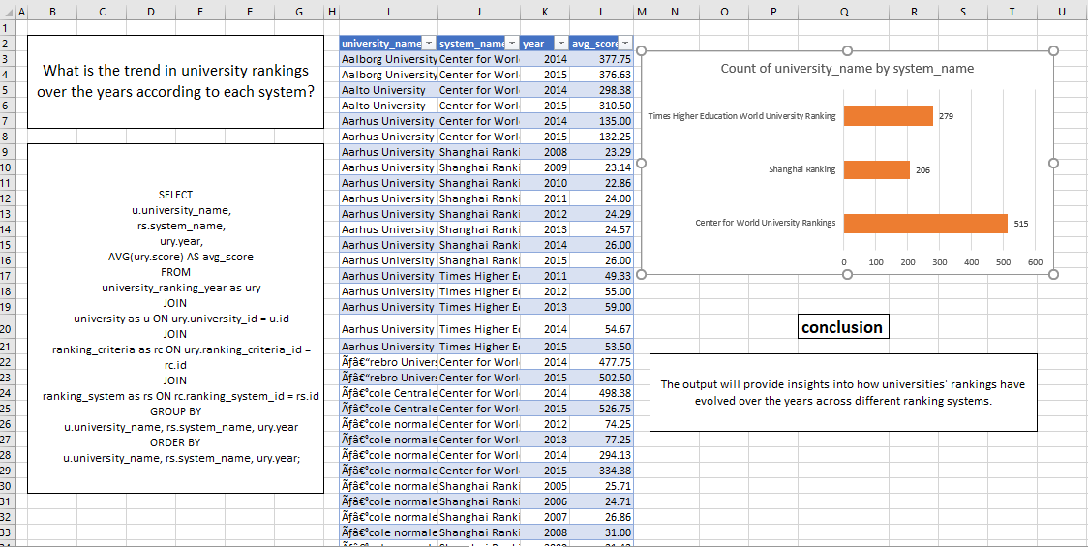
What is the trend in university rankings over the years according to each system?
The output will provide insights into how universities' rankings have evolved over the years across different ranking systems.

Slide 32
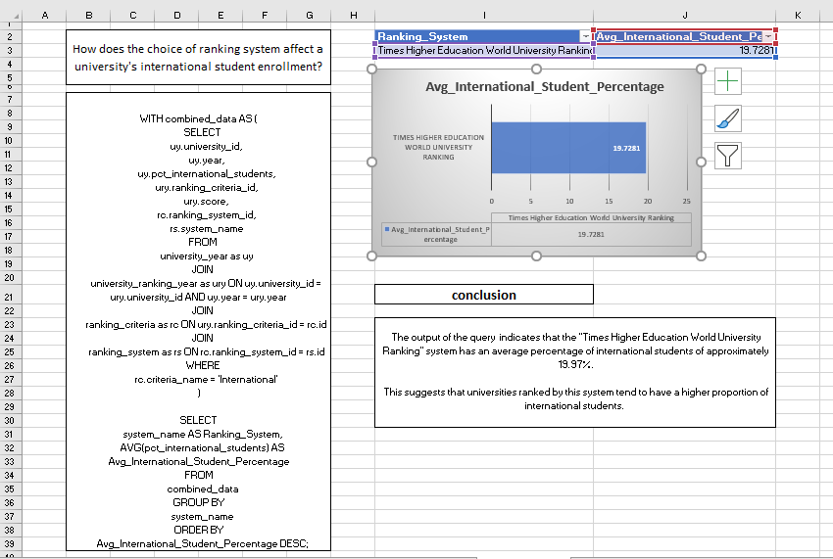
How does the choice of ranking system affect a university's international student enrollment?
The output of the query indicates that the "Times Higher Education World University Ranking" system has an average percentage of international students of approximately 19.97%.
This suggests that universities ranked by this system tend to have a higher proportion of international students. ​

Slide 33
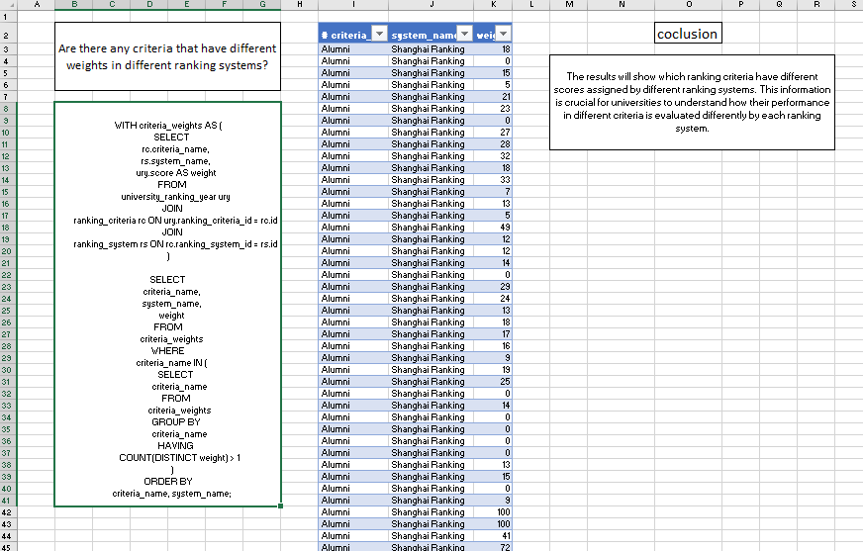
Are there any criteria that have different weights in different ranking systems?
The results will show which ranking criteria have different scores assigned by different ranking systems. This information is crucial for universities to understand how their performance in different criteria is evaluated differently by each ranking system.

Slide 34
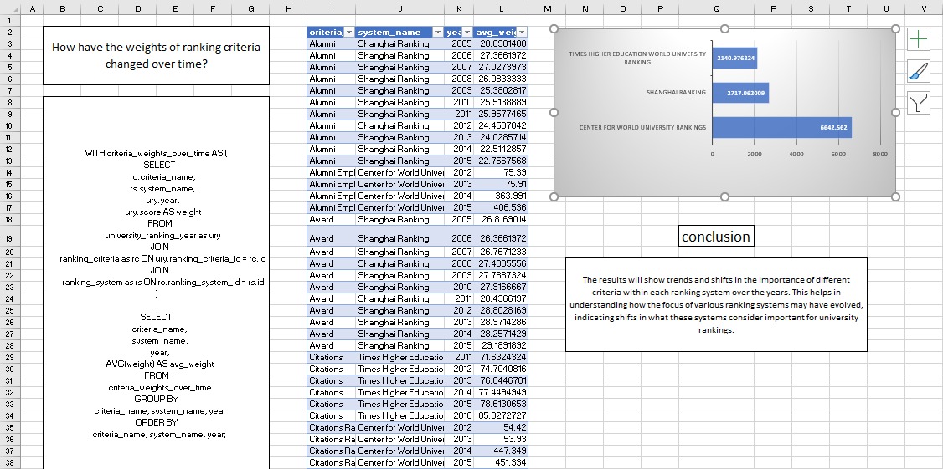
How have the weights of ranking criteria changed over time?
The results will show trends and shifts in the importance of different criteria within each ranking system over the years. This helps in understanding how the focus of various ranking systems may have evolved, indicating shifts in what these systems consider important for university rankings.

Slide 35
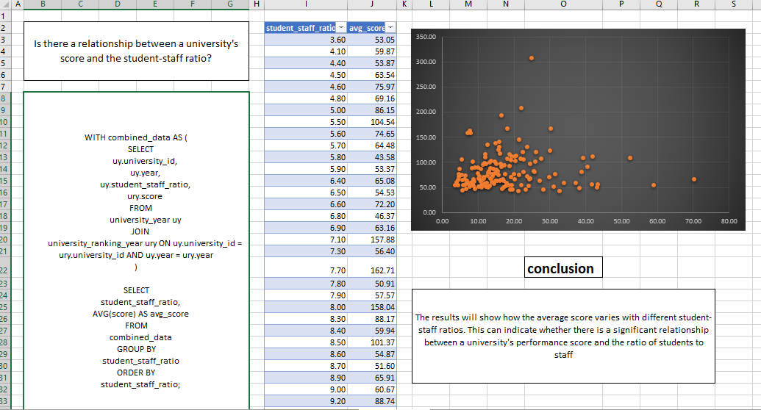
Is there a relationship between a university's score and the student-staff ratio?
The results will show how the average score varies with different student-staff ratios. This can indicate whether there is a significant relationship between a university's performance score and the ratio of students to staff

Slide 36
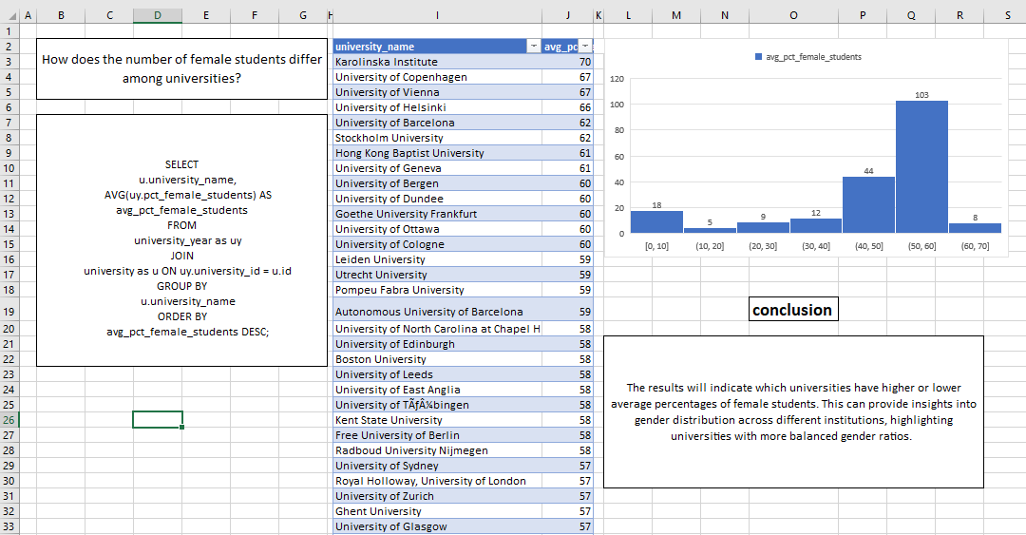
How does the number of female students differ among universities?
The results will indicate which universities have higher or lower average percentages of female students. This can provide insights into gender distribution across different institutions, highlighting universities with more balanced gender ratios. ​

Slide 37
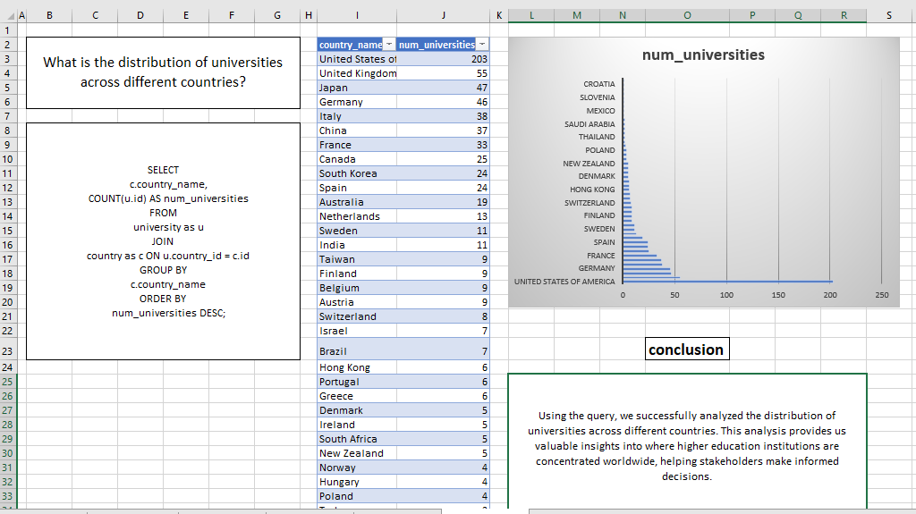
What is the distribution of universities across different countries?
Using the query, we successfully analyzed the distribution of universities across different countries. This analysis provides us valuable insights into where higher education institutions are concentrated worldwide, helping stakeholders make informed decisions.

Slide 38
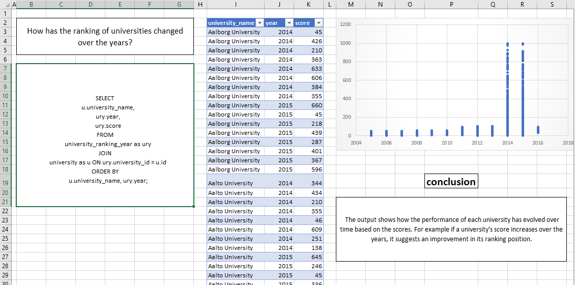
How has the ranking of universities changed over the years?
The output shows how the performance of each university has evolved over time based on the scores. For example if a university's score increases over the years, it suggests an improvement in its ranking position.

Slide 39
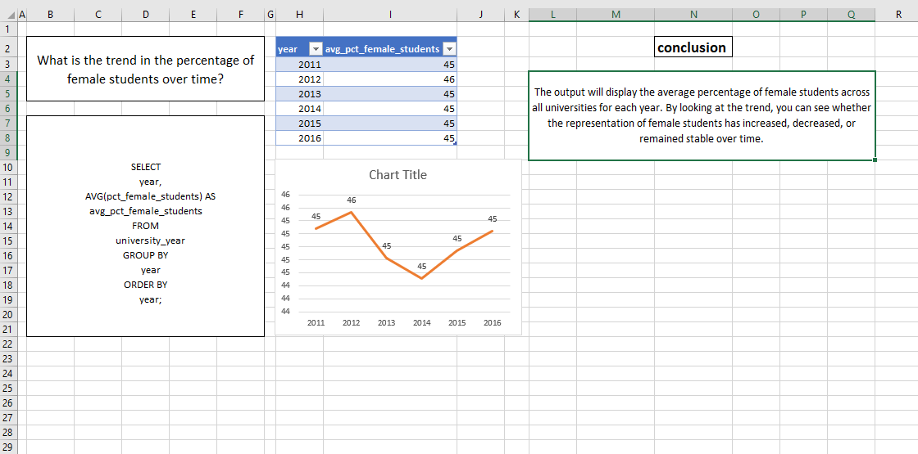
What is the trend in the percentage of female students over time?
The output will display the average percentage of female students across all universities for each year. By looking at the trend, you can see whether the representation of female students has increased, decreased, or remained stable over time.

Slide 40
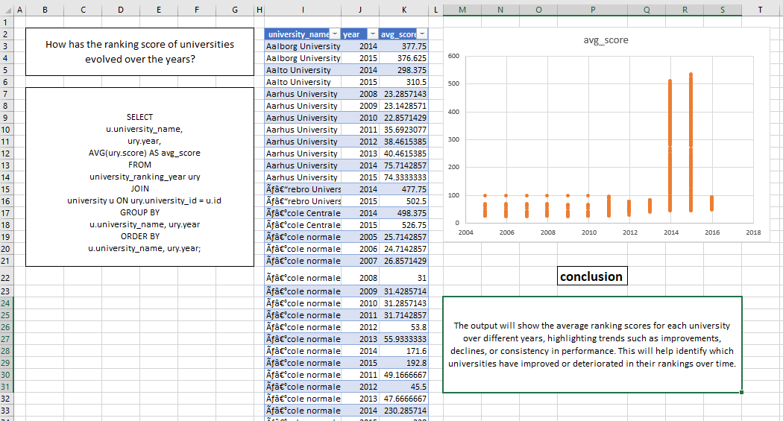
How has the ranking score of universities evolved over the years?
The output will show the average ranking scores for each university over different years, highlighting trends such as improvements, declines, or consistency in performance. This will help identify which universities have improved or deteriorated in their rankings over time.

Slide 41
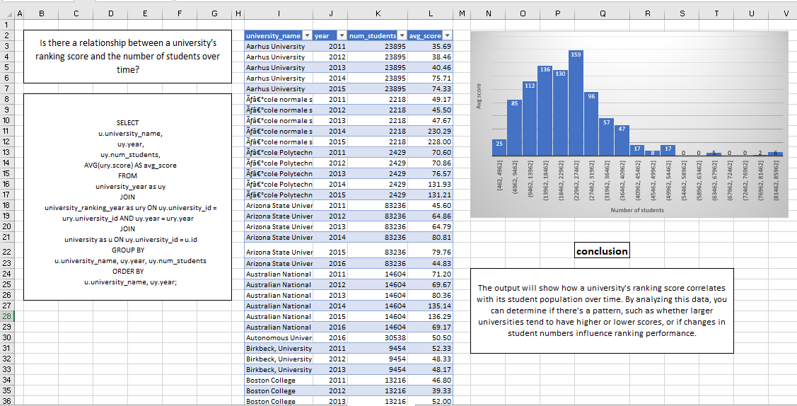
Is there a relationship between a university's ranking score and the number of students over time?
The output will show how a university's ranking score correlates with its student population over time. By analyzing this data, you can determine if there's a pattern, such as whether larger universities tend to have higher or lower scores, or if changes in student numbers influence ranking performance.

Slide 42
Final tips & takeaways
Identify Key Trends: Focus on uncovering significant patterns in university rankings across different systems.
Analyze Ranking Criteria: Assess how criteria like research output and teaching quality influence university positions.
Thorough Data Aggregation: Ensure your data is well-organized and comprehensive for effective exploratory data analysis (EDA).
Track Metric Changes: Highlight changes in important metrics such as student-staff ratios and international student enrollment over time.
Actionable Insights: Aim to provide practical insights that reveal the factors contributing to university success in global rankings.

Slide 43
Thank you
PANKAJ SONKAR
6263252130
pankajsonkar72@gmail.com
https://github.com/pankaj071996/pankaj071996
https://www.linkedin.com/in/pankaj-sonkar-047223216/

